Slide 1

Accident Hotspot Prediction

Slide 2
Problem Statement
Create an accident hotspot prediction system that analyzes and identify hotspot area in different districts based on accident count. The solution should use classification techniques to predict accident hotspot areas.
The problem at hand is to design and implement a data-driven system for identifying, predicting, and visualizing accident hotspots in a region based on historical accident data. This system helps us to reducing accident rates in targeted locations and improving road safety.
The system aims to enhance accident prevention efforts by predicting high-risk areas and providing actionable insights for traffic management and safety planning.

Slide 3
Objective:
Develop a tool that can provide data-driven insights to reduce accident rates in high-risk areas by identifying accident hotspots
Scope:
Dataset Analysis, Data Cleaning, Hotspot Identification.
Tools Used:
Python, Pandas, Matplotlib, Seaborn, and Geospatial libraries.

Slide 4
Data Overview
Dataset Summary:
Rows: [e.g., 20066] - representing individual accidents.
Columns: [e.g.31]:
Key Features:
Attributes: District, PS Name, Accident spot

Slide 5
Steps:
Analyze accident data across multiple districts to identify hotspots.
The system should group accident records by district, police station, and accident spots to calculate the number of accidents in each area and manually assign clusters based on accident counts.
cluster areas based on accident counts and assign labels (e.g., "Low Incident Area" and "Hotspot").
Train Random Forest classifier to predict the accident hotspot cluster.
Evaluate model performance
Accuracy :82%

Slide 6
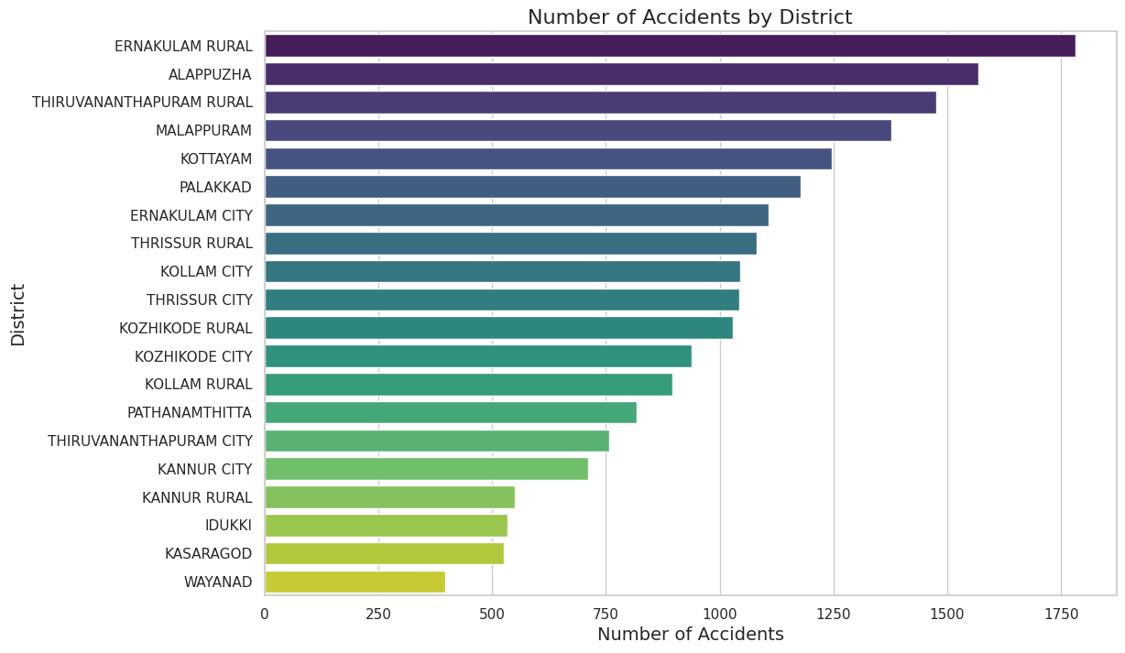
Accident count by District

Slide 7
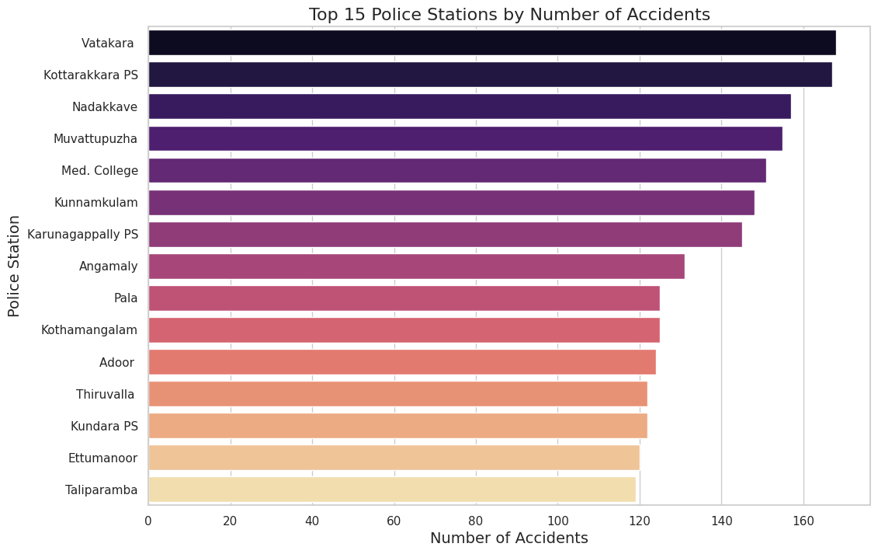
Accident count by PS Name

Slide 8
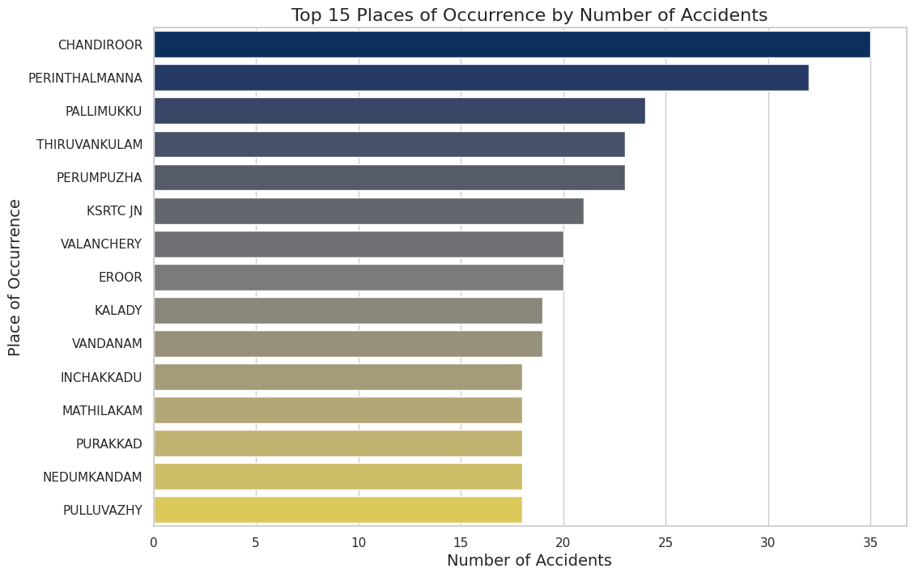
Accident count by Place of Occurrence

Slide 9
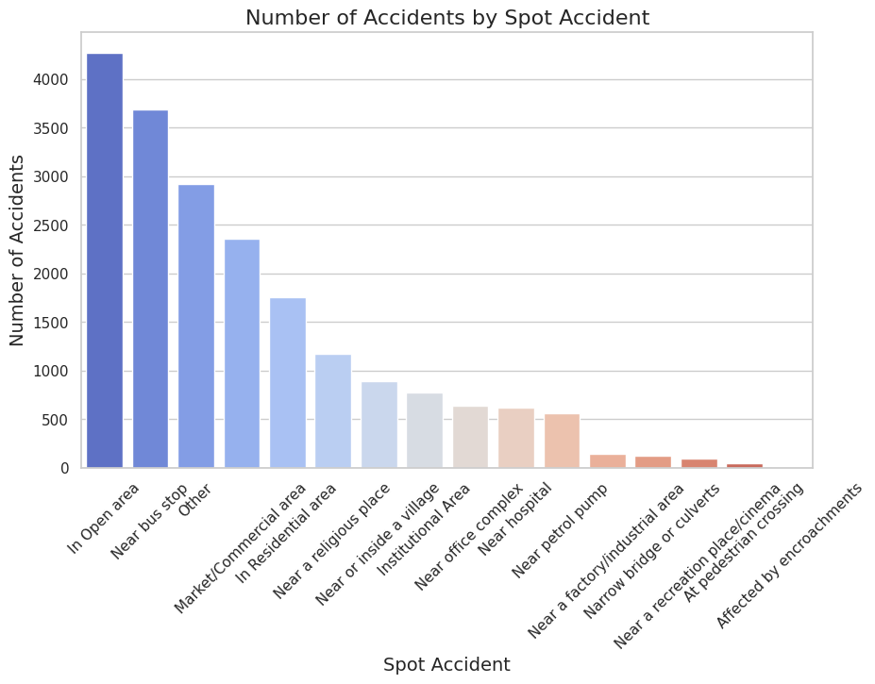
Accident count by Accident Spot

Slide 11
Feature Engineering
Grouping was done on the accident data by district, spot of occurrence, and police station.
The number of accidents for each combination, created a new column with these counts labeled as Accident Count.
As per the Guidelines provided by MoRTH (Ministry of Road Transport and Highways) , a particular place recorded with 5 accidents in a year , can be classified as a hotspot

Slide 12
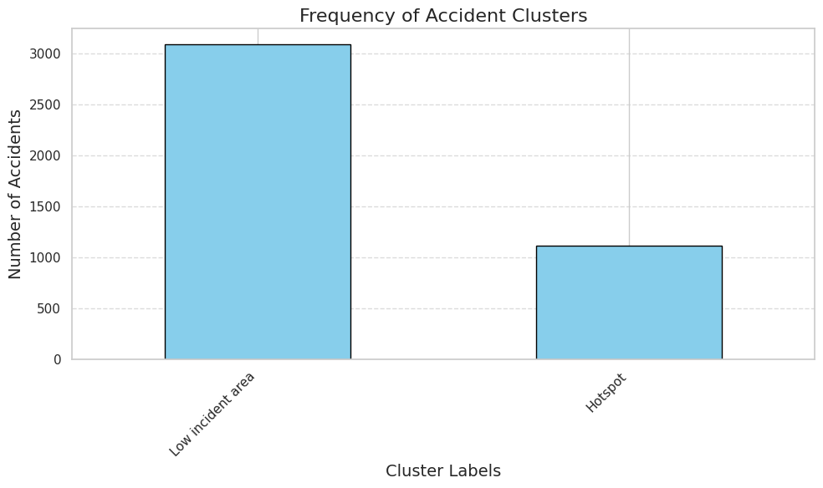
Target Column

Slide 13
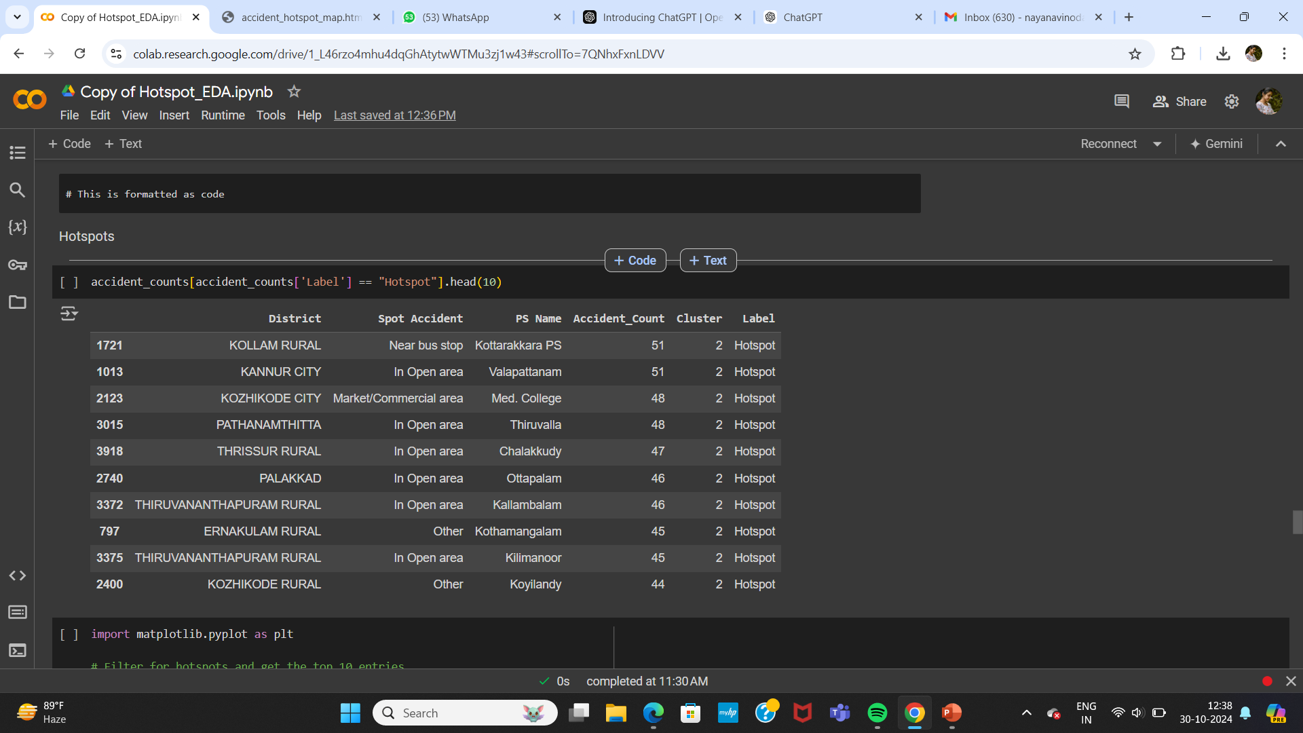
Result

Slide 14
Map
This map visually differentiate accident-prone areas ("Hotspot" locations) and safer areas ("Low Incident Areas") using color-coded markers (e.g., red for hotspots and blue for low-incident areas).
file:///C:/Users/Anugrah/Downloads/accident_hotspot_map.html

Slide 15
Model
Selected Model:
Random Forest Classifier – Accuracy of 82%

Slide 16
Conclusion
Accident Hotspot Prediction and Visualization System is designed to be a valuable tool for enhancing road safety and reducing accident rates by identifying high-risk areas.

Slide 17

Thank You!

